Slide 1
Past Simple

Slide 2
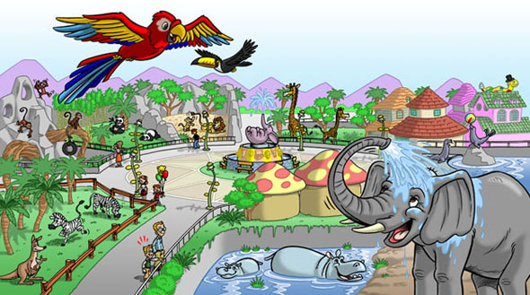
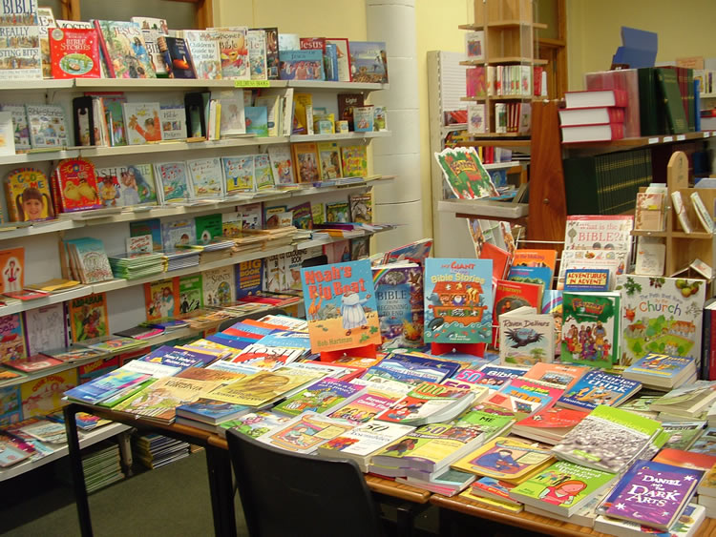
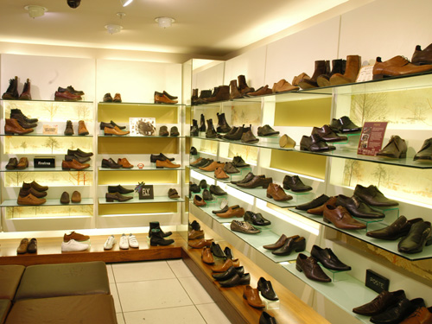

Slide 4
Чему мы научимся на уроке?
Задавать вопросы в Past Simple;
отвечать на вопросы в Past Simple;
расспрашивать друга о покупках;
слушать тексты на английском языке и понимать их.

Slide 5
Did Toby put his mobile into the pocket?

Slide 6
When did they go?

Slide 7
Keys:
1. Where did they go?
2. What did they buy in the mall?
3. What did they have for lunch?
4. What time did they come home?

